Slide 1
WEBINAR SERIES
Sexual Harassment Prevention
at the Workplace
and how you can comply with the new state laws
September 10, 2019 | 1:00pm CST
In collaboration with:

Slide 2
Host
Zee Asghari
Director of Business Development and Partnerships
Auzmor Inc.

Slide 3
Speakers
Brent M. Douglas
Partner at Martenson Hasbrouck & Simon LLP
San Diego, California.
Has a nationwide practice focused on California compliance and litigation defense.
Counsels companies both large and small on corporate structure.

Slide 4
Speakers
Dr. Nima Moayedi
CEO & Founder of Psychology Works, Inc.
Orange County, California.
Licensed clinical psychologist (PSY 27997).
Worked at the California Department of Corrections & Rehabilitation – Psychiatric Inpatient Program for five years.
Spent three years as the supervising forensic evaluator testifying on criminal forensic cases.

Slide 5
About Auzmor
“Powerfully Simple Employee Training”
Auzmor is an HR Software as a Service (SaaS) company, working behind the scenes to help companies enhance employee training, cultivate, and develop a growing workforce.
“I have found that the Human Resources space is such a fragmented one. There’s not one place that has all of the solutions for the department which are LMS, ATS, HRIS and PMS. We wanted one system to have all those different functions for HR. So, we decided to focus on one product, build it up really good and compete in that space. Our LMS competes with other LMSs, our ATS competes with other ATSs, and so on. We have powerful and intuitive HR software products that integrate with each other seamlessly. Every Auzmor’s product is user-friendly and feels similar to using Facebook and LinkedIn. Nobody would have to be trained to use them.”
- Darryl Jose, CEO of Auzmor, Inc.

Slide 6
Takeaways
The right ways to deal with workplace harassment
Input from legal industry professionals
Tools to help train employees and supervisors

Slide 7
We’re covering 7 topics
Definition of sexual harassment
Psychology of workplace harassment
Effects of workplace harassments
Case examples from lawyers
Proper actions of dealing with workplace harassment
The legal process
Tools you need

Slide 8
Workplace Harassment Statistics
Based on ABC News – Washington Post poll on Oct 2017:
54% of women have experienced workplace harassment
30% said it involved a man at work
23% said it involved a supervisor
EEOC task force reports that:
Since 2010, employers have paid a total of $699 million to employees claiming they were harassed
An estimate of settlements and court judgments in 2012 that amounted to more than $356 million in costs
NBC survey on November 2017 shows that:
Fewer than 1 in 5 companies have made an effort to discuss appropriate conduct, hold training, or change sexual harassment policy in the wake of #MeToo and #TimesUp

Slide 9
Sexual Harassment Definition
A form of sex discrimination under Title VII of the Civil Rights Act of 1964.
Applies to all US employers with 15 or more employees
Equal Employment Opportunity Commission (EEOC) Definition:
"Unwelcome sexual advances, requests for sexual favors, and other verbal or physical conduct of a sexual nature constitutes sexual harassment when submission to or rejection of this conduct explicitly or implicitly affects an individual's employment, unreasonably interferes with an individual's work performance or creates an intimidating, hostile or offensive work environment."

Slide 10
Types of Sexual Harassment
Quid Pro Quo
Latin for “this for that”
An employer conditions a workplace benefit upon the acceptance of a sexual advance
Hostile Work Environment
Employer makes the working environment so hostile that it interferes with employee’s work

Slide 11
Categories of Sexual Harassment
Verbal – jokes, comments, and sexual advances
Visual – pictures, posters, and cartoons
Physical – touching, massaging, and encroaching on personal space
Written – email communication with any of the above or links to inappropriate websites or images

Slide 12
Dispelling Sexual Harassment Myths
Only women can be harassed
Not true! All gender identities could be harassed.
Same sex offender won’t be considered as a harasser
Not true! The US Supreme Court has recognized that harassment can occur between similar sex.
Only supervisors can be a harasser
Not true! Anyone regardless of job positions can be a harasser.

Slide 13
Sexual Harassment is broken down into 5 groups:
Gender Harassment
Seductive Behavior
Sexual Bribery
Sexual Coercion
Sexual Imposition
Source: American Psychological Association

Slide 14
1.
Gender Harassment
Generalized sexist statements and behavior that convey insulting or degrading attitudes about women or men.
Examples: Insulting remarks, obscene jokes or humor about sex, etc.
Source: American Psychological Association

Slide 15
2.
Seductive Behavior
Unwanted, inappropriate and offensive sexual advances.
Examples: repeated and unwanted sexual invitation; insistent requests for dates/dinner/drinks; persistent letters, phone calls, etc.
Source: American Psychological Association

Slide 16
3.
Sexual Bribery
Solicitation of sexual activity or other sex-linked behavior by promise of reward; the proposition may be either overt or subtle.
Examples: “You scratch my back, and I’ll scratch yours”, harasser demands victim to engage in a sexual activity in exchange for favors or promotions.
Source: American Psychological Association

Slide 17
4.
Sexual Coercion
Coercion of sexual activity or other sex-linked behavior by threat of punishment.
Examples: negative performance evaluations, withholding of promotion, threat of termination.
Source: American Psychological Association

Slide 18
5.
Sexual Imposition
Gross sexual imposition.
Examples: forceful touching, feeling, grabbing, or sexual assault/battery.
Source: American Psychological Association

Slide 19
Perpetrator
Perpetrators chose to commit harassment because they have power without consequences.
They continue with the behavior although have been requested to stop it by the victims because of the beliefs surrounding the stressor.
Example: “It was a joke!”, “Everyone does it!” (power in numbers).

Slide 20
Why Victims Don’t Speak Out
A betrayal trauma can occur when a boss or mentor abuses a positive relationship to harass the victim.
That kind of trauma can result in betrayal blindness.
Betrayal blindness is when a victim intentionally looks the other way to prevent confronting those feelings of betrayal.
Institutional betrayal usually occurs when a company or organization does nothing to prevent harassment (or in some work cultures, even encourages it).
Irrational beliefs that it’s in some way they are partially at fault or to blame.

Slide 21
Mental Health Consequences of Sexual Harassment
Anxiety
Anger
Fear
Humiliation
Substance abuse
Phobias
Depressive symptoms
Self-blame
Post traumatic stress
Feeling powerless
Isolating behaviors

Slide 22
Symptoms from Experiencing Sexual Harassment
Depends on the individuals:
Perception of the event
Genetic predispositions
Lifelong environmental factors:
At home, did they have a voice? Did it change outcomes?
Their thoughts about the event:
Did I cause this? vs No one deserves to feel this way. (Empowerment, I can make a difference for others)

Slide 23
Physiological Reactions
Headaches
Lethargy
Sexual problems
Gastrointestinal distress
Dermatological reactions
Panic reactions
Sleep disturbances
Weight fluctuation

Slide 24
Best coping methods for the victim
In “Back Off! How To Confront and Stop Sexual Harassment and Harassers”, Martha Langelan recommends taking these steps:
Do the unexpected
Hold the harasser accountable for their actions
Make honest, direct statements (Speak the truth)
Demand for the harassment to stop
Don’t respond to harasser’s excuses or diversions
The harasser’s behavior is the issue
Reinforce statements with strong, self-respecting body language
Respond at an appropriate level

Slide 25
Effects of Workplace Harassment
Any conduct that makes your employees less enthusiastic about works takes a toll on the bottom line
Even mild harassment that may or not break any state law reduces company morale and, in turn, profitability
Of course, when harassment is found, the costs can be tremendous
An employee is entitled to lost wages, emotional distress damages, and attorneys’ fees

Slide 26
Lawyer’s Experience in Solving Harassment Cases
Currently litigating more than 100 sexual harassment cases
Common thread among them is text messages
Employees exchange phone numbers for work purposes, but can lead to trouble
Offenders can send inappropriate messages through personal devices without employers knowing

Slide 27
Examples of current cases
A security guard received text messages from the guard who relieved her with sexually explicit images and invitations to have sex at work
A law firm partner has his assistant sit in his lap
A retail associate claims her supervisor was taking pictures of her in the changing room

Slide 28
How should employees deal with workplace harassment?
Employees should report any harassment to Human Resources
Whether they actually witness it, receive a complaint about it, or even just hear a rumor of it
There are no brownie points for conducting an investigation yourself
You should not fail to report an incident if you believe it likely falls short of the definition of harassment
Pass the buck, and always involve someone else

Slide 29
How should employers deal with workplace harassment?
Employers should conduct annual training
Constantly remind supervisors of the importance of involving Human Resources.

Slide 30
Legal Process of Filing a Harassment Complaint
In most states, there is an administrative process, such as the EEOC
In California, the Department of Fair Employment and Housing
That has jurisdiction over a sexual harassment claim, but this is a minor obstacle to a full-blown lawsuit
Employers can usually see these lawsuits coming, so properly addressing them in severance packages is the best, most cost-efficient approach

Slide 31
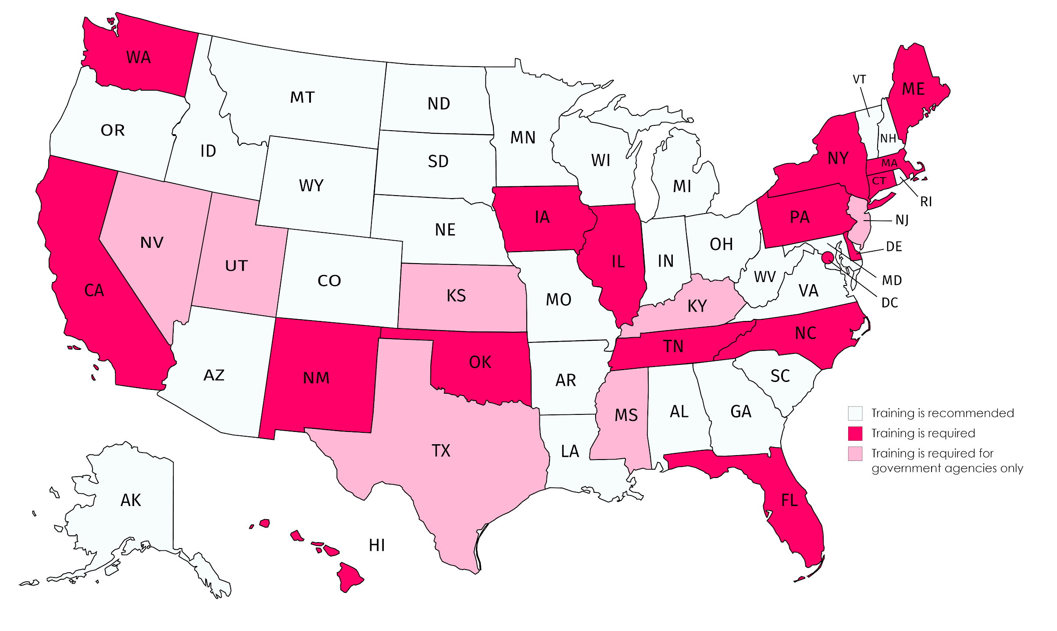
Workplace Harassment Prevention Training According to State Laws

Slide 32
How do we stop this unwanted behavior?
Leveraging a third-party training provider is the number one way for people to understand:
What constitutes harassment
How it can negatively impact a workplace
How to prevent it

Slide 33
The Tools You Need
Technology and automation are essential:
LMS platform to help pull reports & track the training
Access training anywhere from any device
Third-party content providers
Easier auditing process

Slide 34
Q&A Session

Slide 35
Resources Contact Information
Dr. Nima Moayedi
nima@auzmor.com
www.psy.works
Brent Douglas
bdouglas@martensonlaw.com
www.martensonlaw.com

Slide 36
THANK YOU.
Get in touch with us!
@auzmor
www.auzmor.com

